Slide 1




Object Oriented Programming
Kwaii Lottery
March 10, 2021
By: Mai La

Slide 2
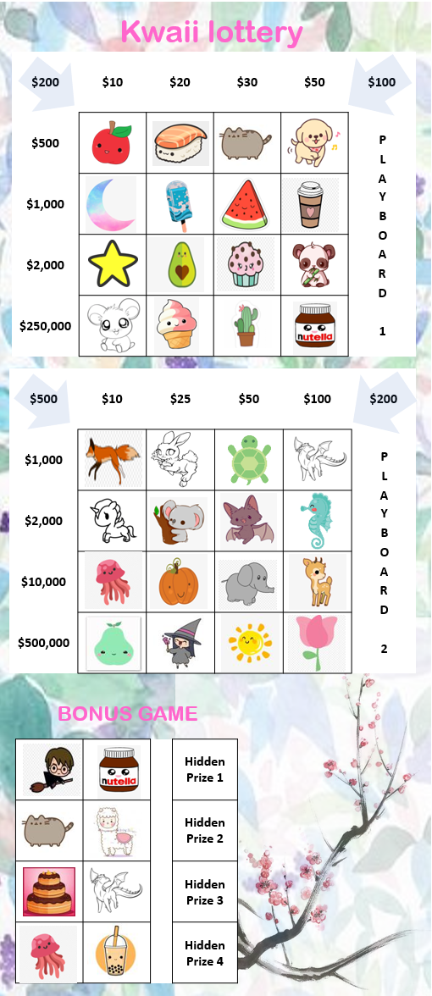
Game design
HOW TO PLAY?
Buy a ticket for $5 and have a chance to win up to $500,000 by matching symbols
3 ticket designs, 10 ticket numbers
28 symbols to be revealed, scratch out any that matched on the ticket
Win the prize for any matching row, column, diagonal
Hidden prize is revealed at the end of the game
CHANCE TO WIN
50% no win
40% win up to $2,000
10% win up to $500,000

Slide 3
Objects
Note - color coding:
class: Bold
Input attributes: blue
Output attributes: red
Methods: black()
MainGame
-------
ticket_num
design_num
-------
__init__
choose_ticket()
display_ticket()
play()
MainGame:
Prompt player to choose a ticket design & ticket number
>> choose_ticket()
# Output: ticket_num, design_num
>> display_ticket()
# Output: show the picture of the ticket to player
>> play()
# Output: navigate through the game
PlayBoard:
Return the ticket symbols
>> choose_design()
# Input: design_num # Output: ticket_sym
Get winning prize for a matched row, column, or diagonal
>> get_prize(win_set)
# Input: win_set, prizes # Output: win_prize
BonusBoard
Child class of playboard, set random prizes for bonus game
>> set_bonus()
# Input: prizes # Output: bonus
Get winning prize for a matched bonus row
>> get_prize(win_set)
# Input: win_set, bonus # Output: bonus_prize
PlayBoard
-------
design_num ticket_sym
win_set win_prize
-------
__init__(design_num)
choose_design()
get_prize(win_set)
Algorithm
-------
ticket_num chance
ticket_sym call_bank
sym_bank caller_sym
-------
__init__(ticket_num, ticket_sym)
get_win_chance()
get_algo()
algo1()
algo2()
algo3()
BonusBoard (PlayBoard)
-------
design_num bonus
win_set bonus_prize
-------
set_bonus()
get_prize(win_set)
CallerBoard
-------
PlayBoardObj win_bank
caller_sym total_win
-------
__init__(PlayBoardObj, caller_sym)
display_caller()
get_win_set()
display_final_prizes()
Symbol
-------
sym_bank symbol
-------
__init__(symbol)
display_sym()

Slide 4
Objects
Note - color coding:
class: Bold
Input attributes: blue
Output attributes: red
Methods: black()
Algorithm:
Get the winning chance from the ticket number
>> get_win_chance()
# Input: ticket_num # Output : chance
Choose an algorithm to run base on the winning chance. Return the 28 caller symbols
>> algo1() # No win
>> algo2() # Win up to $2,000
>> algo3() # Win up to $500,000
# Input: ticket_sym, sym_bank_bank # Output : call_bank
>> get_algo()
# Input: chance, call_bank # Output : caller_sym
CallerBoard:
Display caller symbols & picture of symbols to player
>> display_caller()
# Input: caller_sym, PlayBoardObj # Output: symbol picture
Get winning set from the caller symbols, display bonus hidden prizes & total winning prizes
>> get_win_set()
# Input: caller_sym # Output : win_bank
>> display_final_prizes()
# Input: win_bank # Output: display bonus_prize, total_win
Symbol
Store the bank of all symbols & path to their pictures
Show the picture of a symbol to the player
>> display_sym()
# Input: symbol # Output: symbol picture
MainGame
-------
ticket_num
design_num
-------
__init__
choose_ticket()
display_ticket()
play()
PlayBoard
-------
design_num ticket_sym
win_set win_prize
-------
__init__(design_num)
choose_design()
get_prize(win_set)
Algorithm
-------
ticket_num chance
ticket_sym call_bank
sym_bank caller_sym
-------
__init__(ticket_num, ticket_sym)
get_win_chance()
algo1()
algo2()
algo3()
get_algo()
BonusBoard (PlayBoard)
-------
design_num bonus
win_set bonus_prize
-------
set_bonus()
get_prize(win_set)
CallerBoard
-------
PlayBoardObj win_bank
caller_sym total_win
-------
__init__(PlayBoardObj, caller_sym)
display_caller()
get_win_set()
display_final_prizes()
Symbol
-------
sym_bank symbol
-------
__init__(symbol)
display_sym()

Slide 5
Running & Testing
HOW TO PLAY?
Run in the command line: python kwaii_lottery.py
Read the Help Menu and How To Play instruction
You can enter any options that the game is asking. If an invalid answer is entered, it will print out a helpful message and repeat the question, until you enter a valid answer.
A picture of your game ticket will be shown in a separate window, use Photos drawing tool to keep track of your game progress.
A screen shot example of how I play and enter different answers is shown in the game_demo.ipynb file, it could also be used for testing the output of each class separately.

Slide 6

Enjoy the game!

